Slide 1
LEAF – Toolbox (Landscape Evolution and Forecasting)
Richard.Fernandes@nrcan-rncan.gc.ca
Notes:
Title changed due to a delay in delivering the lichen cover mapping presentation.
Most work was done before I joined in CCRS. With contribution/support from Prof. Jing Chen’s group.
It looks like a big title – but I will only focus on two satellite data, first, the soil moisture data from SMAP, and second, the SIF from GOME2

Slide 2
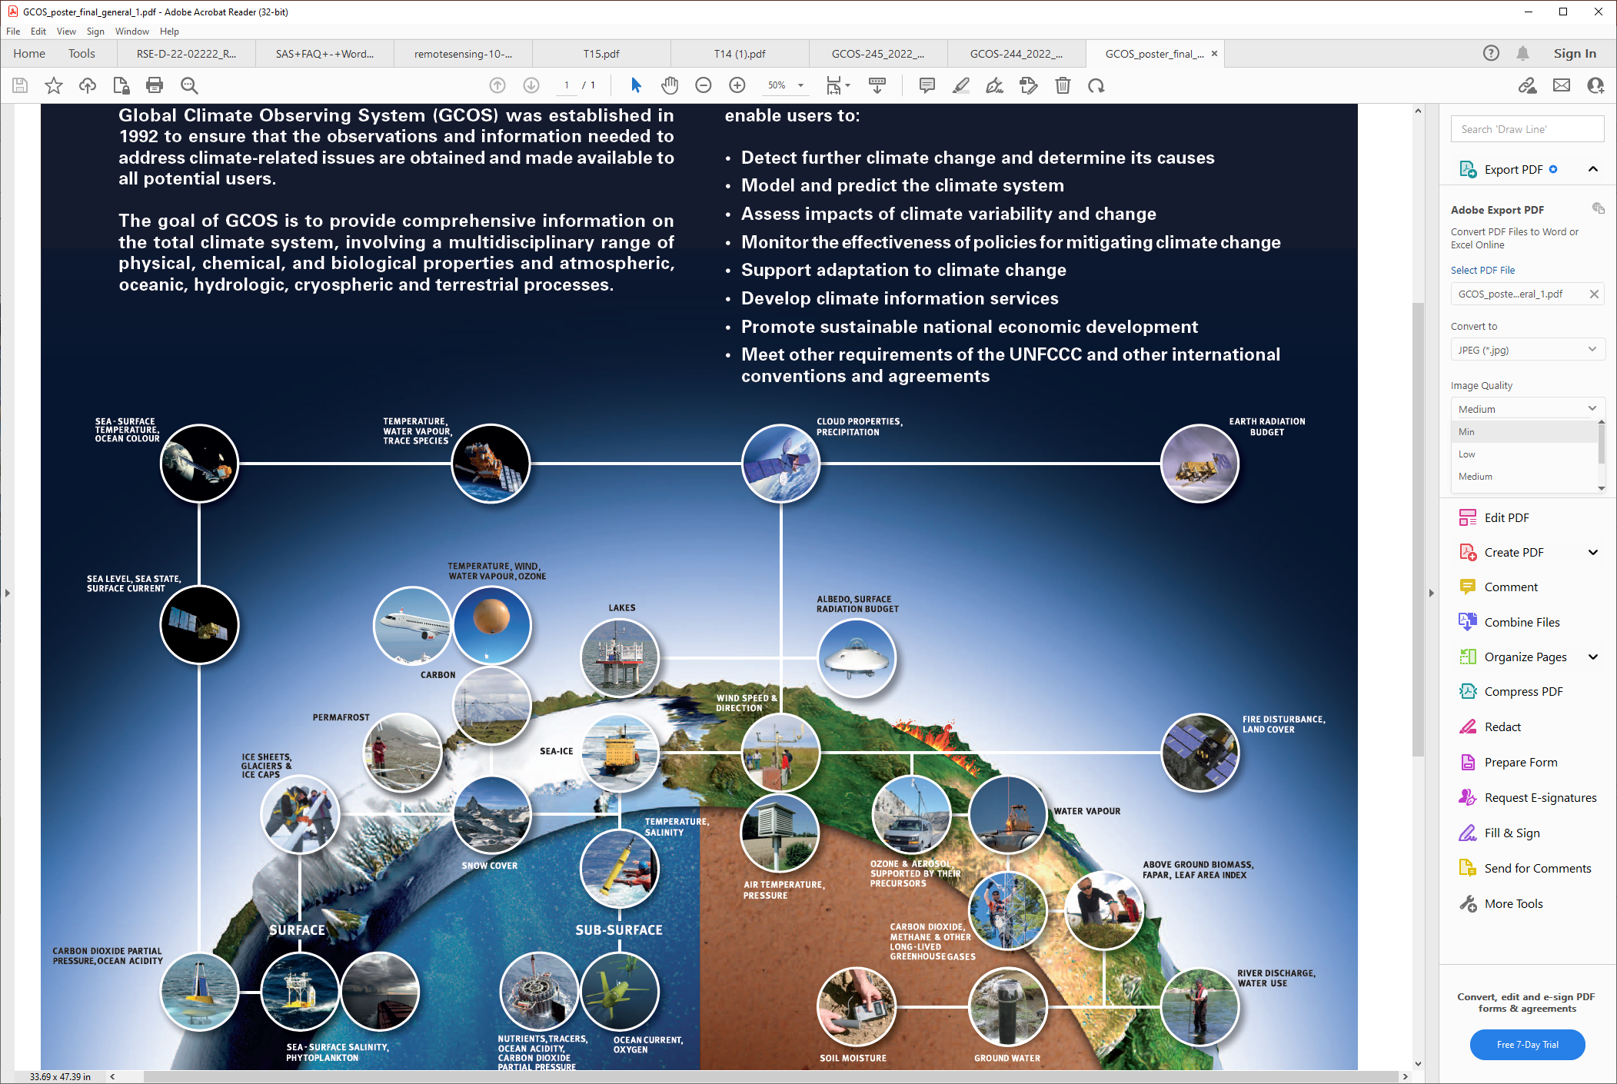

Purpose: Vegetation Essential Climate Variables
Canopy Cover (fCOVER)
Foliage presence
Habitat
Land cover change
fAPAR
Foliage productivity/health
Status and trends
Crop modelling
Leaf Area Index
Foliage density/biomass
Status and trends
Ecosystem/weather models
Surface Albedo
Ecosystem/weather models
https://gcos.wmo.int/en/essential-climate-variables

Slide 3
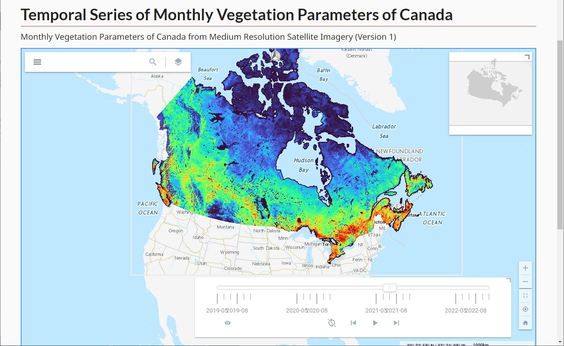
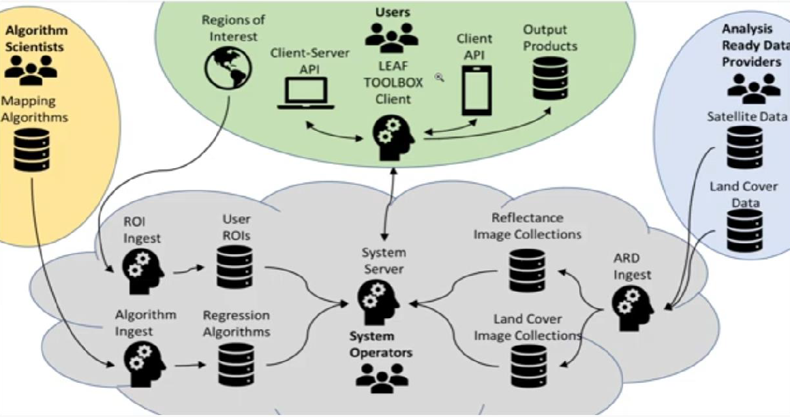
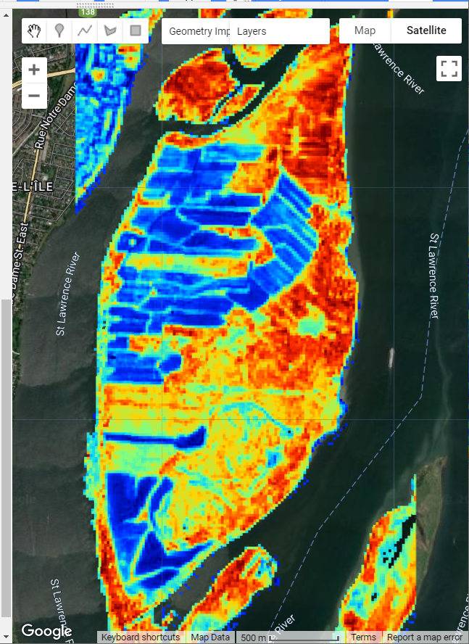
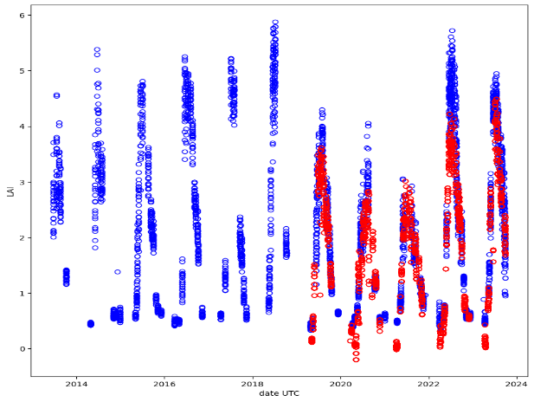
Description
ML Algorithms uploaded using as Tensor Flow like objects
ARD inputs using ESA/USGS/GEE API (free and open)
Free and open algorithms
ARD outputs interoperable at Canada and Global levels

Slide 4
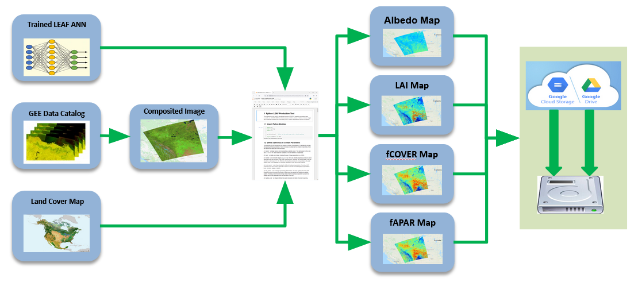
Description
Analysis Ready Input Data
Algorithms
Dataset | Source | Resolution | Official Access | Other Access
Surface Reflectance | ESA Sentinel 2A & 2B | 10m, daily | Copernicus Data Hub | AWS,GEE
Surface Reflectance | USGS Landsat 5,7,8,9 | 30m, daily | Earth Explorer | AWS,GEE
Land Cover | NALCMS North America | 30m, annual | Geo.ca | AWS,GEE
Land Cover | Coprenicus Global Land Service | 100m, annual | AWS,GEE | AWS,GEE
Water Cover | ECCC | 30m, annual | Geo.ca | AWS
Elevation | Tokyo University | 90m | GEE | GEE

Slide 5
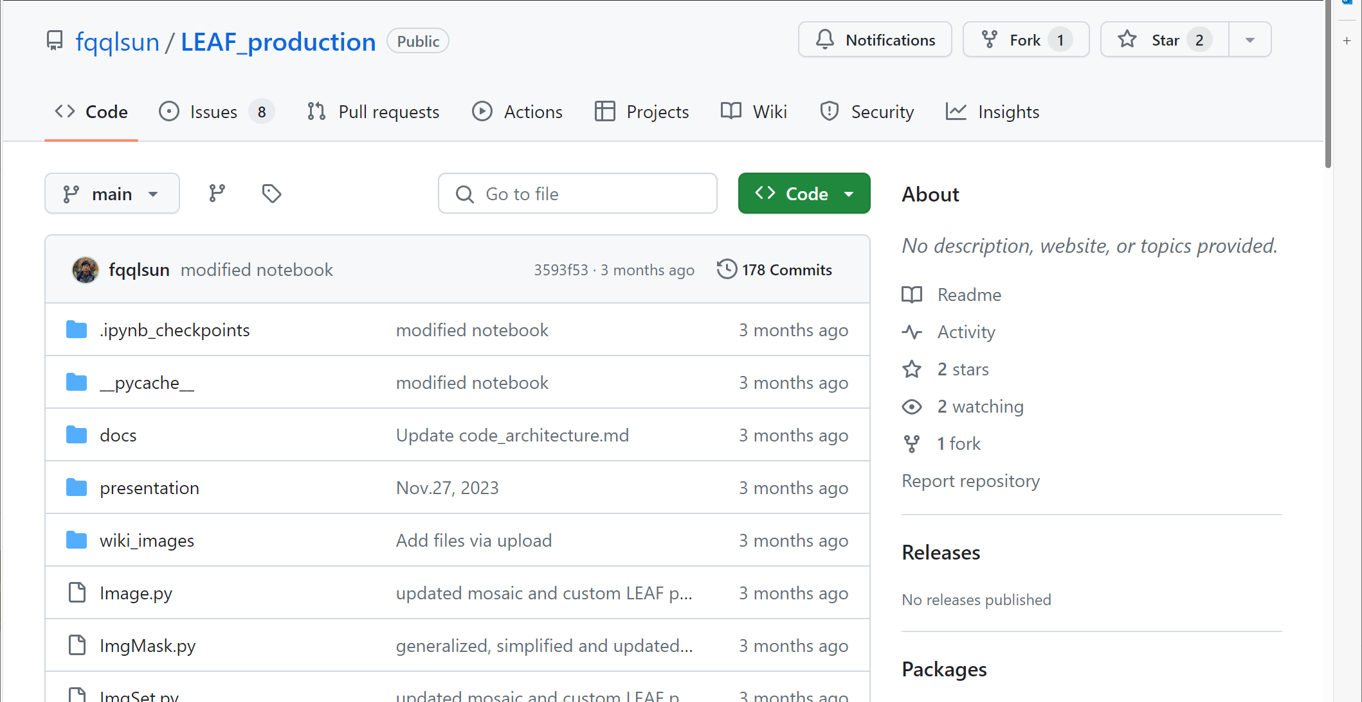
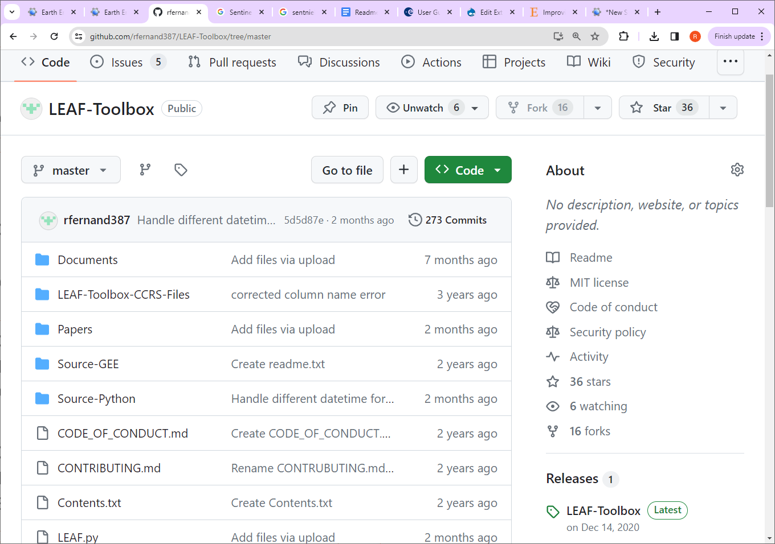
Description
Spatial Processing
Temporal Processing

Slide 6
Technical capabilities expected of DEC Prototype
Back End
Front End
Global Multi archive access (Landsat, Sentinel 1,2,3, Modis)
GEE API option (OAUTH)
Load balancing, auto scaling
Mosaicing/subsetting/reprojection on the fly
GIT integration of input algorithms
Tensor Processing Hardware
Generative AI tools
Python Notebook interface (a la Federal Science Data Hub)
Job Scheduler
Export to Cloud or Local Drive
Copernicus Data Hub Like Query/Production Functionality
EODMS Export
External access

Slide 7
Updated Storage and Compute Requirements
Storage (annual)
Compute
Dataset | Granules | Volume (Tb)
Landsat (2013+) | 100,000 | 60
Sentinel-2 (2016+) | 600,000 | 480
MODIS/S3 (2000+) | 1000 | 1
500m Products (2000+) | 1460 | 1
20m Products | 72 | 5
Requirement | GEE EECU-hr | 48 core, high ram
Canada 30d, 20m | 50000 | 1 month
Canada 30d, 30m | 10000 | 1 week
Regional stack,10m | 1000 | ?
Local stack, 10m | 100 | ?
Canada 1d, 500m | ? | ?

Slide 8
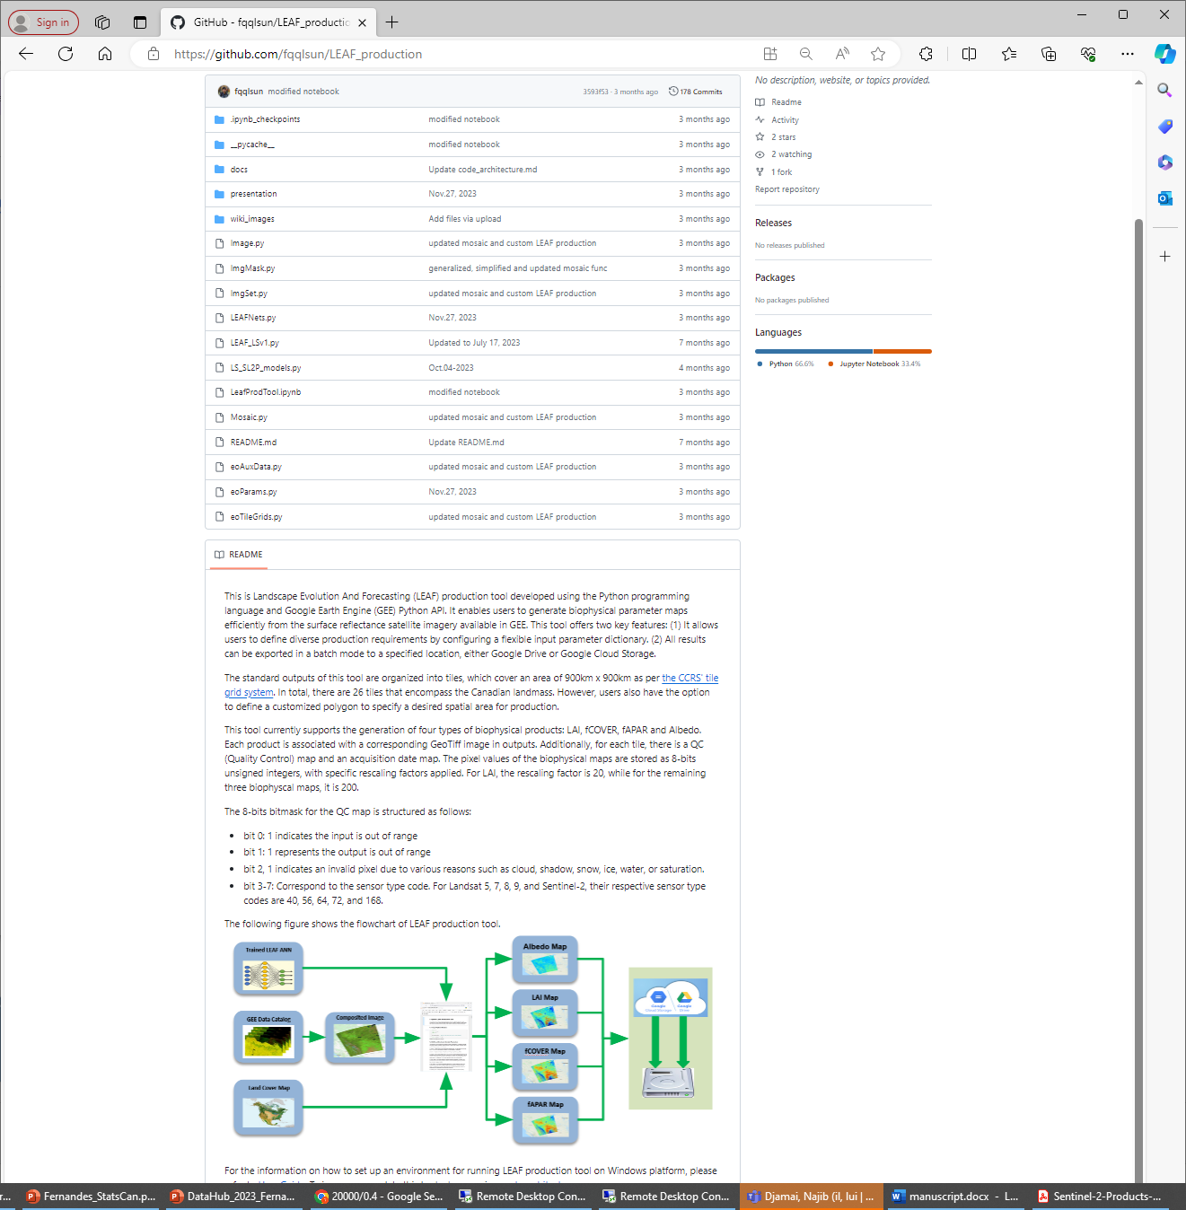
Time Period & Result
Schedule
Result: GitHub - fqqlsun/LEAF_production
20m & 30m monthly – now
20m and 30m local – now
500m daily – September 2024

